Slide 1
Introduction to Data Science with Python
WMASDS04
Week 06: Regression Analysis with Python

Slide 2
Outlines
Linear Regression,
Simple Linear Regression Model
Multiple Linear Regression Model
Nonlinear Regression
Polynomial Regression
Sparse Model
Least Absolute Shrinkage and Selection Operator (LASSO Regression)
Logistic Regression.
Python tools for regression analysis

Slide 3
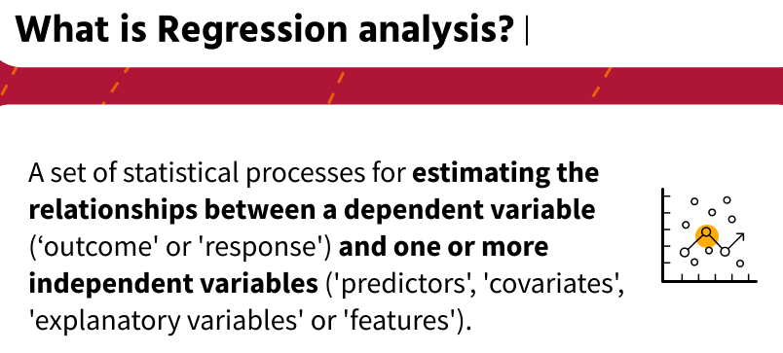
.

Slide 4
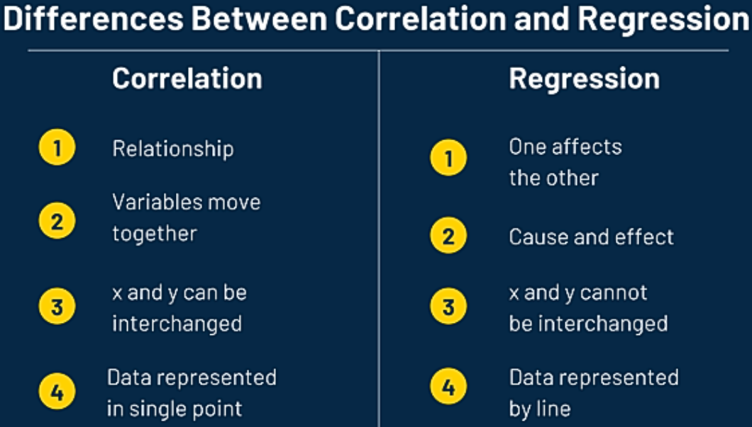
.

Slide 5
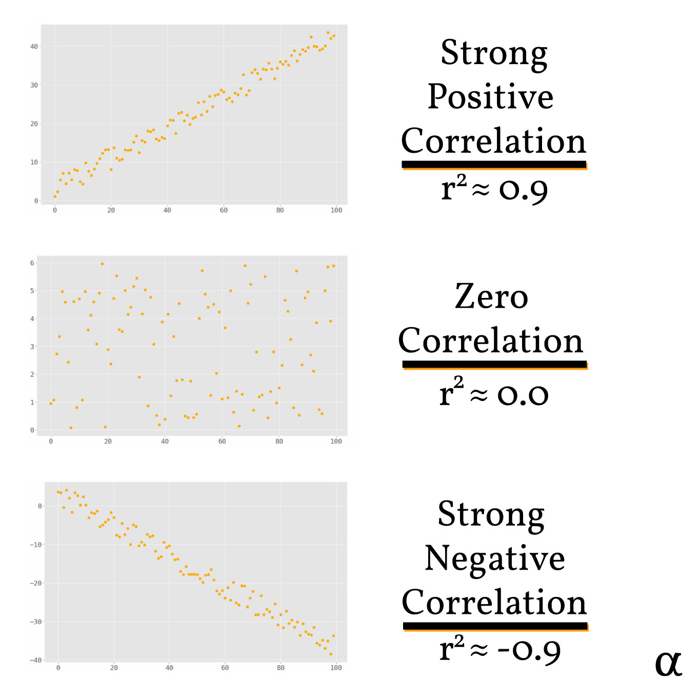

Slide 6
Regression | Dependent | Independent
Simple | One | One
Multiple | One | More than one
Multivariate | More than one | One or more
.

Slide 7
Research Questions
How does sales volume change with changes in price?
How is sales volume affected by the weather?
How does the title of a book affect its sales?
How does the amount of a drug absorbed vary with the patient’s body weight; and does this relationship depend on blood pressure?
How many customers can I expect today?
At what time should I go home to avoid traffic jams?
What is the chance of rain on the next two Mondays; and what is the expected temperature?

Slide 8
Regression Model
response can be expressed as a combination of one or more (independent) variables.
This process involves the transition from data to model.
Regression model can be useful in different tasks:
(1) analyzing the behavior of data (the relation between the response and the variables),
(2) predicting data values (whether continuous or discrete), and
(3) finding important variables for the model.

Slide 9
Assumptions of Linear Regression
Linearity
Homoscedasticity
Independence
Normality
No Multicollinearity

Slide 10
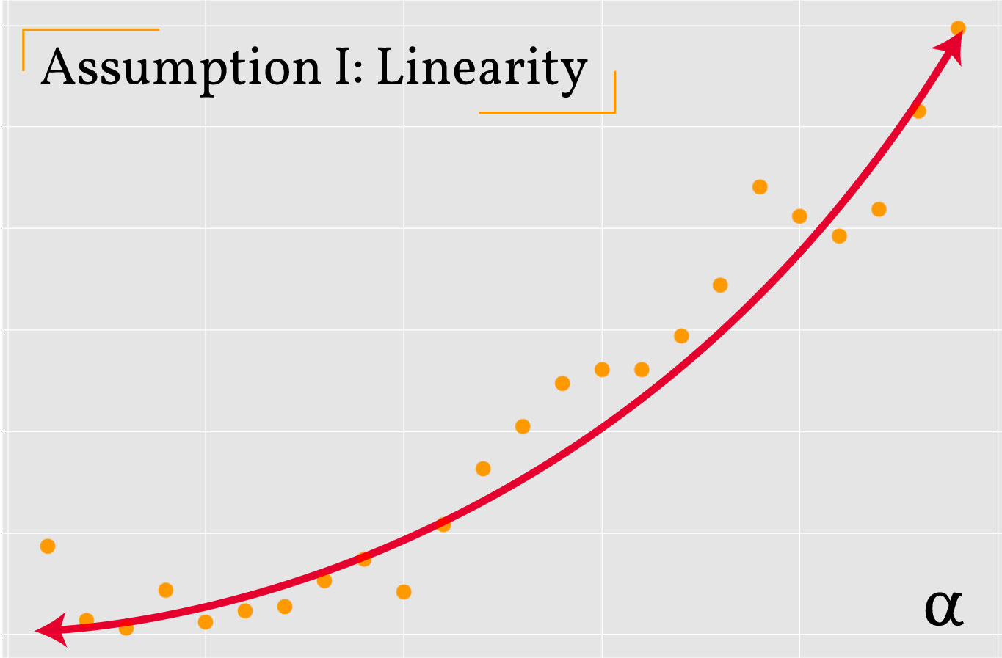
non-linear relationship between variables in violation of the linearity assumption.

Slide 11
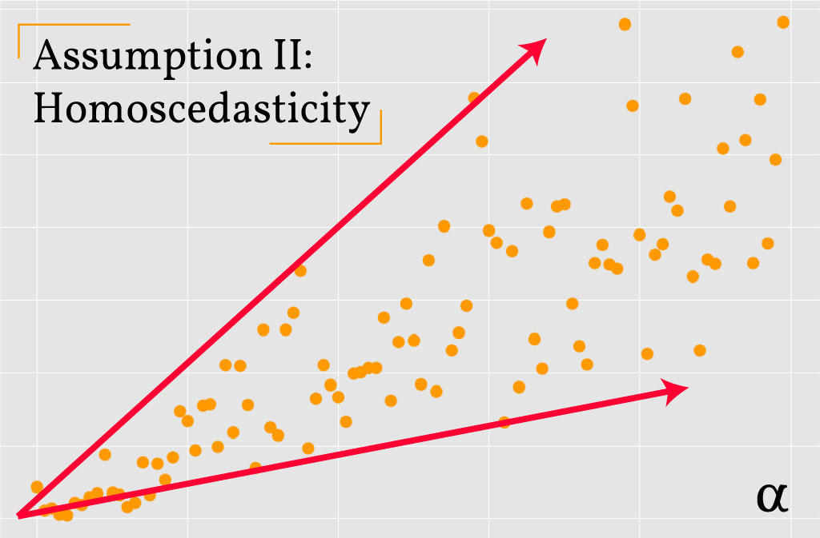
Heteroscedastic relationship between variables in violation of the homoscedasticity assumption.

Slide 12
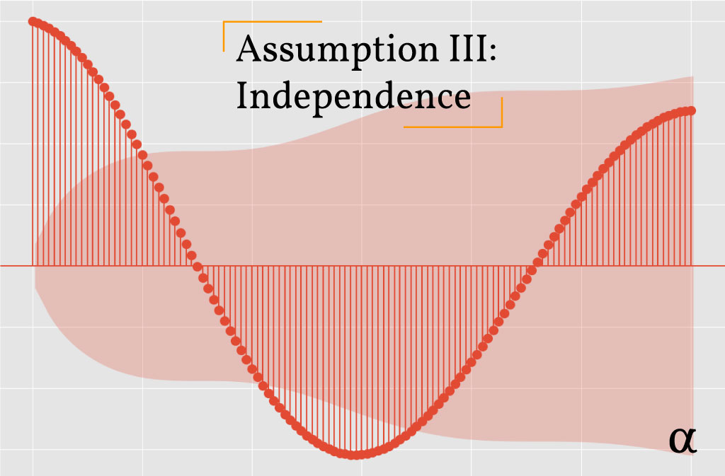
An autocorrelation plot showing a dependency among predictor variables in violation of the independence assumption

Slide 13
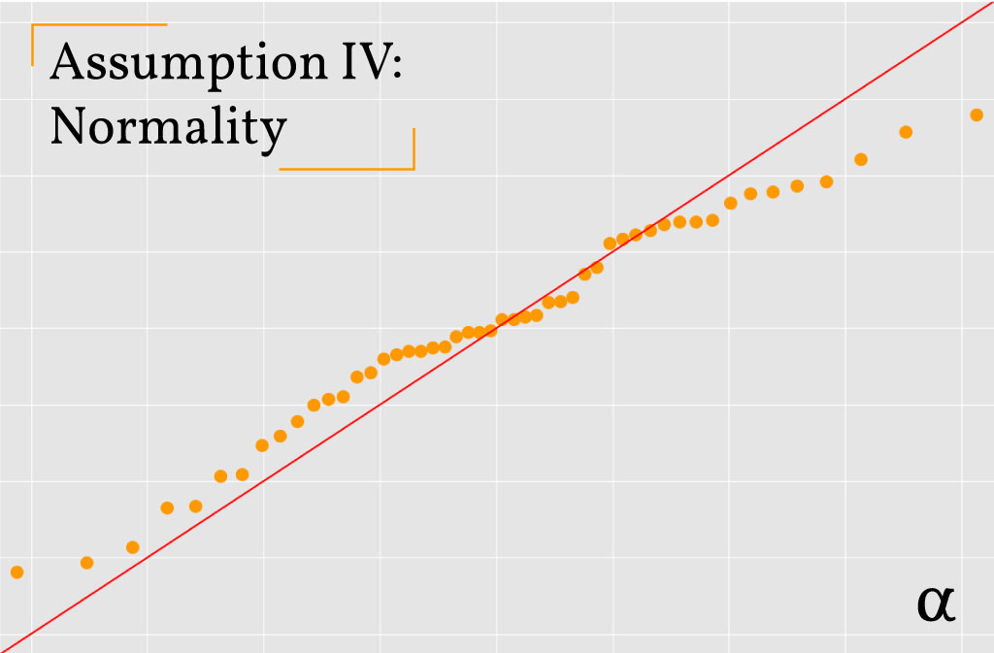
Q-Q Plot of residuals illustrating an approximately-normal distribution in accordance with the normality assumption.

Slide 14
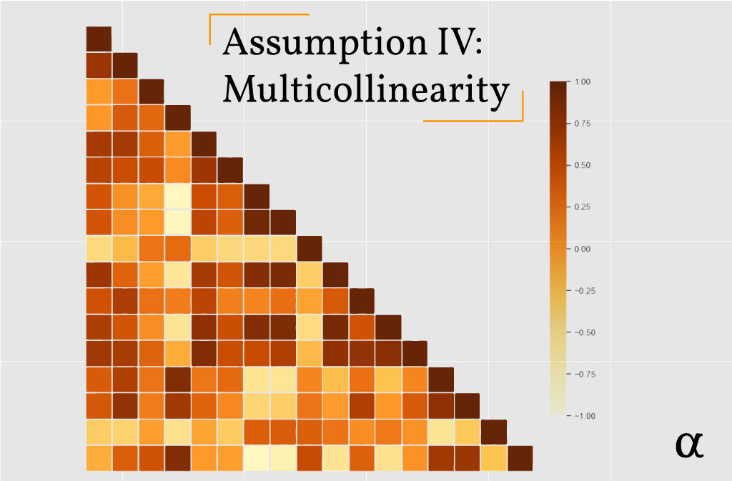
A correlation matrix showing several strong linear relationships among predictor variables in violation of the assumption of no Multicollinearity

Slide 15
Simple Linear Regression
Simple linear regression describes the relationship between a dependent variable and an independent variable with a linear model of y on x:
y = a₀ + a₁x + e,
where the parameter a₀ is called the intercept or the constant term
a₁ is known as the regression coefficient.
We can only establish that change in the value of the outcome variable (Y) is associated with change in the value of feature X,
regression technique cannot be used for establishing causal relationship between two variables.

Slide 16
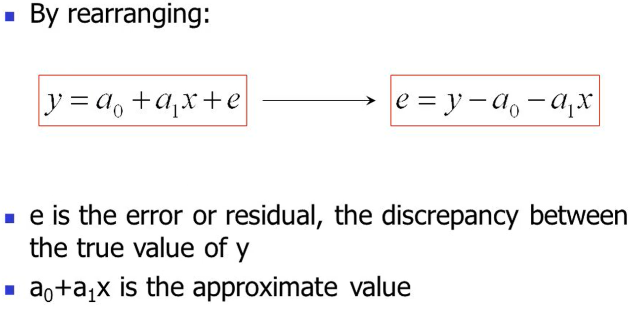
.

Slide 17
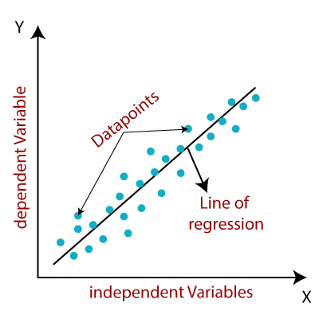
.

Slide 18
Assumptions of Linear Regression
Linearity
Homoscedasticity (constant variance)
Independence
Normality
Multicollinearity

Slide 19
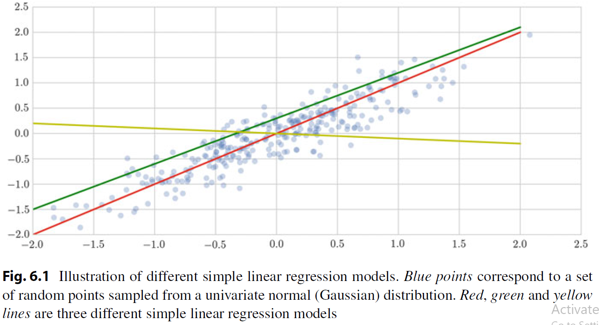
Best Fitted Line?
.
.

Slide 20
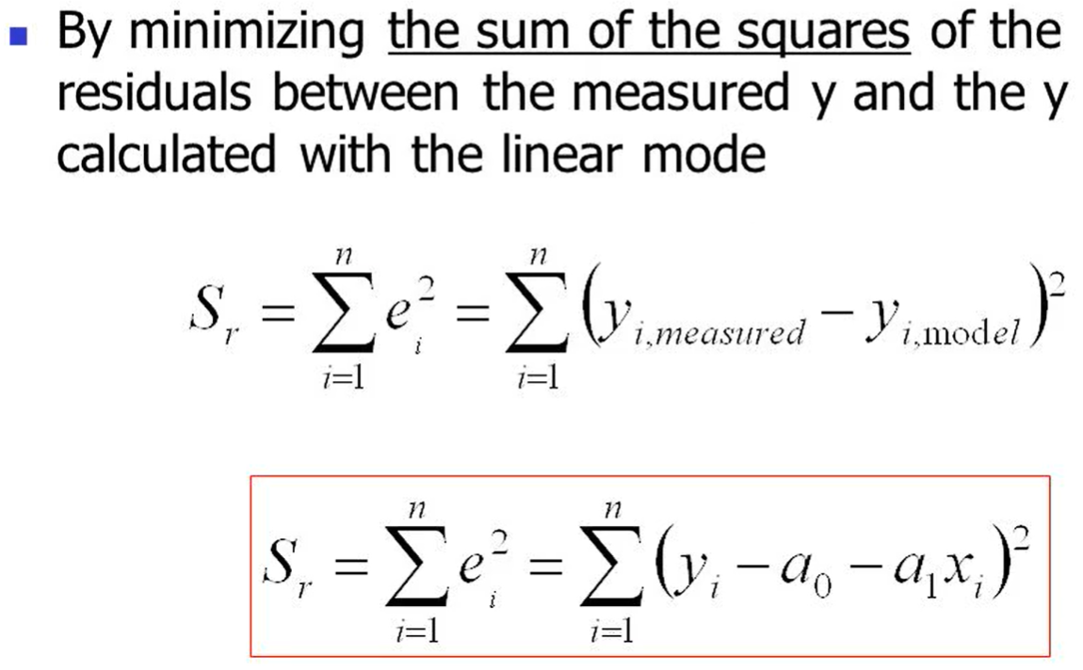
Ordinary Least Square Method
.

Slide 21
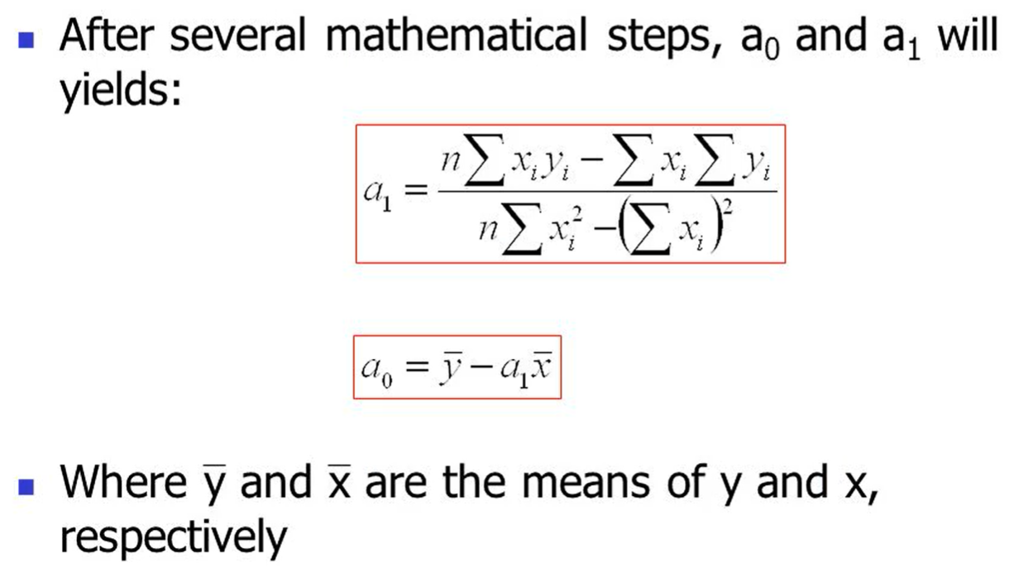
Coefficients of SLR Model
.

Slide 22
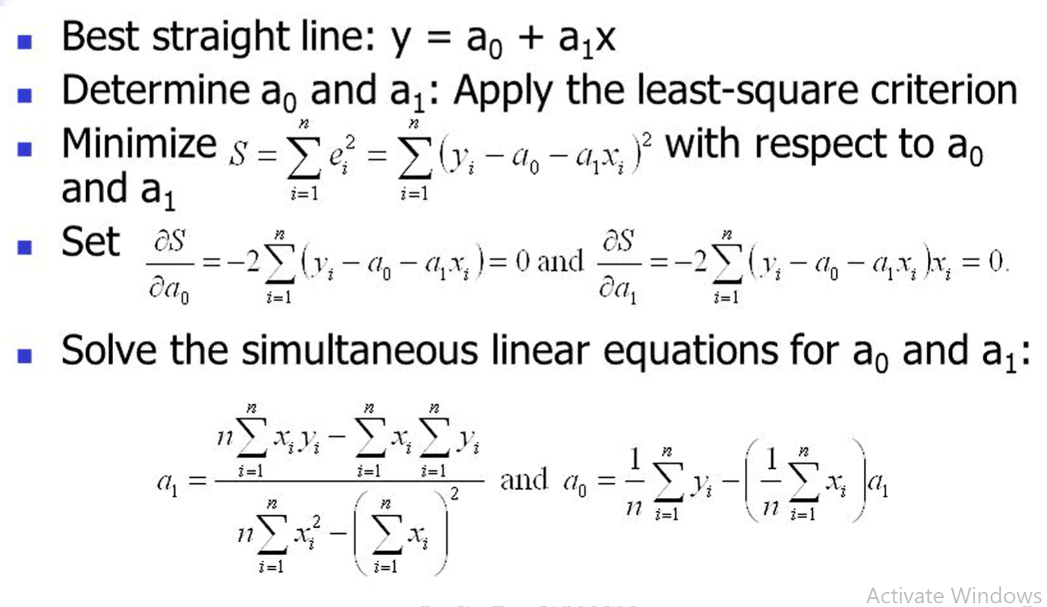
OLS to SLR Model
.

Slide 23
Practical Case: Sea Ice Data and Climate Change
Research question: Is the climate really changing?
we want to show the effect of the climate change by determining whether the sea ice area (or extent) has decreased over the years.
Sea ice area refers to the total area covered by ice, whereas sea ice extent is the area of ocean with at least 15% sea ice. Reliable measurement of sea ice edges began with the satellite era in the late 1970s. Before then, sea ice area and extent were monitored less precisely by a combination of ships, buoys, and aircraft.
In order to check whether there is an anomaly in the evolution of sea ice extent over recent years, we want to build a simple linear regression model and analyze the fitting; but before we need to perform several processing steps.

Slide 24
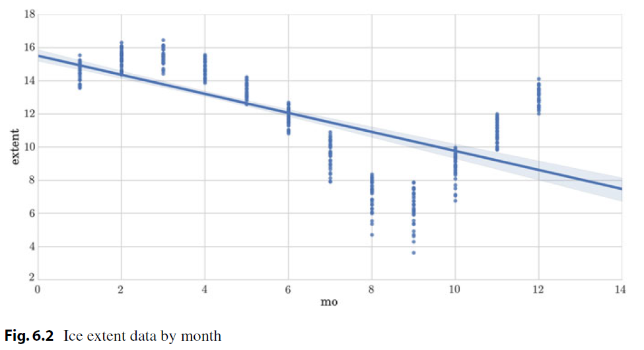
.

Slide 25
Different Types of Regression Model
Simple linear regression describes the relationship between the variable and the response with a straight line. y = a₀ + a₁x
In the case of multiple linear regression, we extend this idea by fitting a d-dimensional hyperplane to our d variables.
y = a₀ + a₁x₁ + · · · + a_{d}x_{d}
When the response depends on the variables in nonlinear ways, this model then consider nonlinear transformations φ(·) of the variables:
y = a₁φ(x₁)+· · ·+a_{d}φ(x_{d} )
This model is called polynomial regression and it is a popular nonlinear regression technique which models the relationship between the response and the feature variables as an p-th order polynomial.
However, using higher-order polynomial can involve computational complexity and overfitting.
Overfitting occurs when a model fits the characteristics of the training data and loses the capacity to generalize from the seen to predict the unseen.

Slide 26
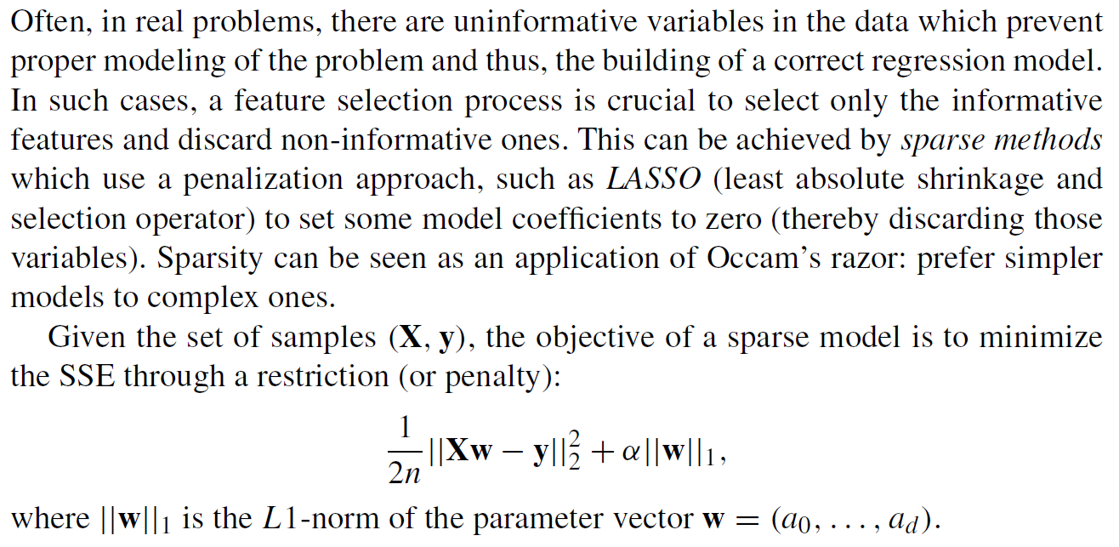
Sparse Model
.

Slide 27
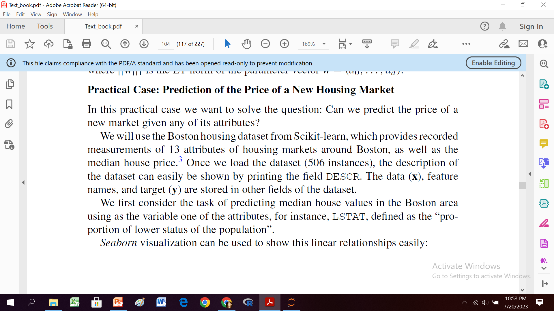
Example
.
.

Slide 28
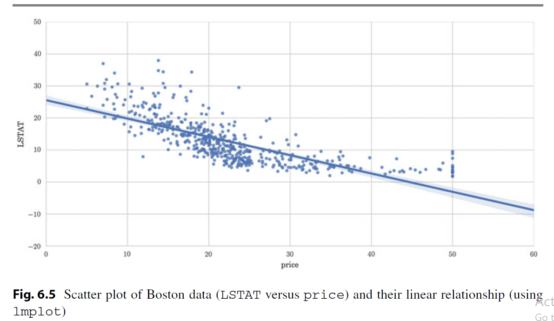
.
.

Slide 29
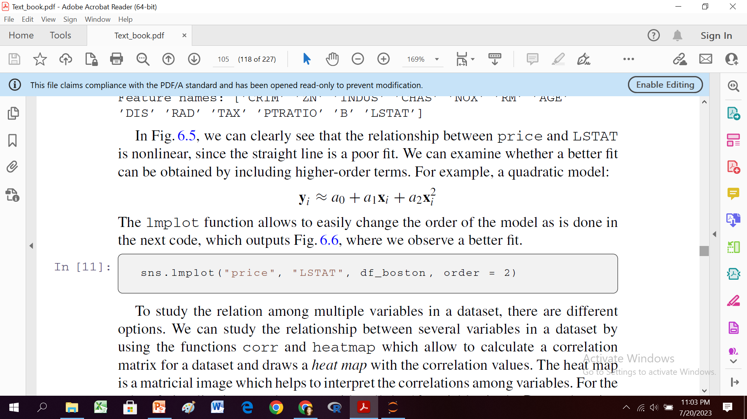
.

Slide 30
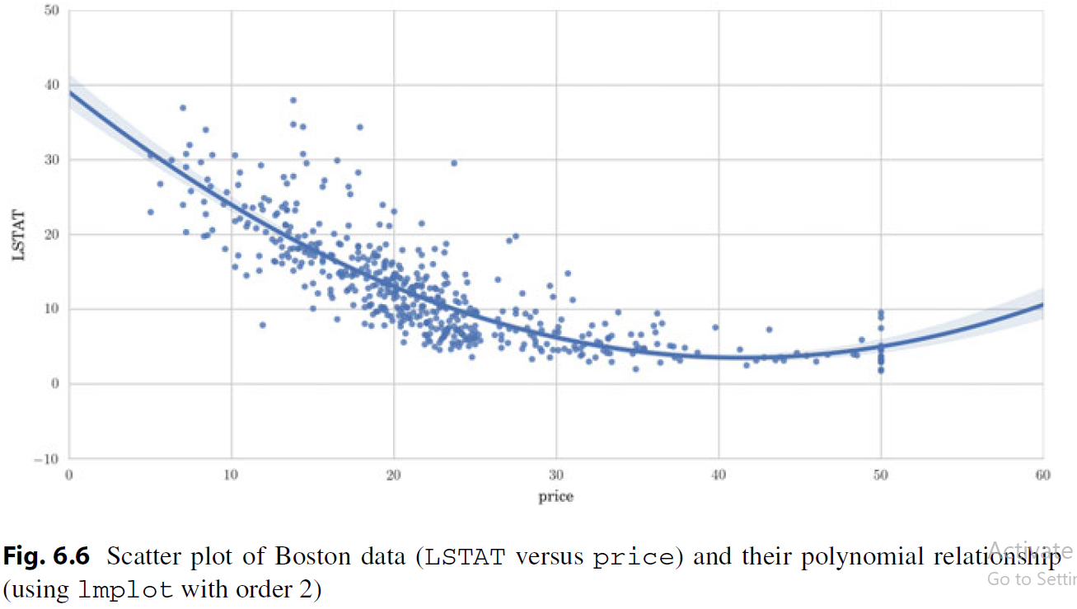
.

Slide 31
To study the relation among multiple variables in a dataset, there are different options.
We can study the relationship between several variables in a dataset by using the functions corr and heatmap which allow to calculate a correlation matrix for a dataset and draws a heat map with the correlation values.
The heat map is a matricial image which helps to interpret the correlations among variables.
For the visualization, we consider six variables in the Boston housing data,
CRIM, per capita crime rate by town;
INDUS, proportion of non-retail business acres per town;
NOX, nitric oxide concentrations (parts per 10 million);
RM, average number of rooms per dwelling;
AGE, proportion of owner-occupied units built prior to 1940; and
LSTAT.

Slide 32
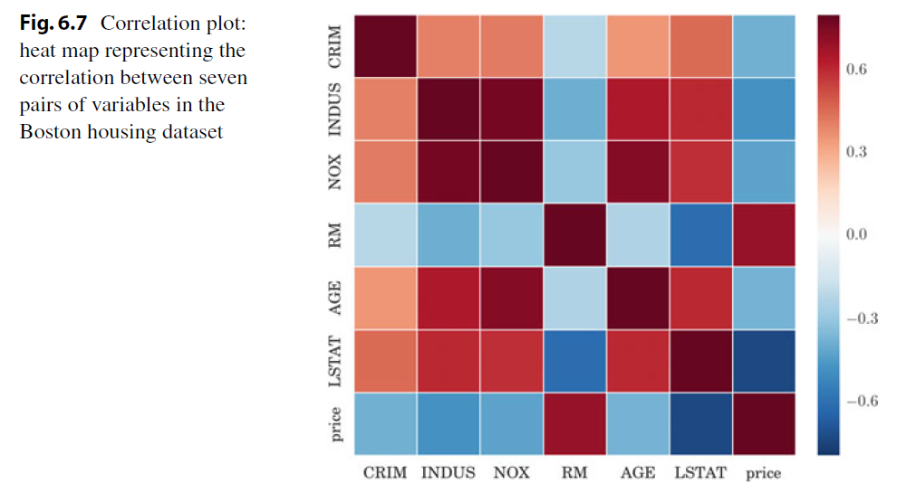
.

Slide 33
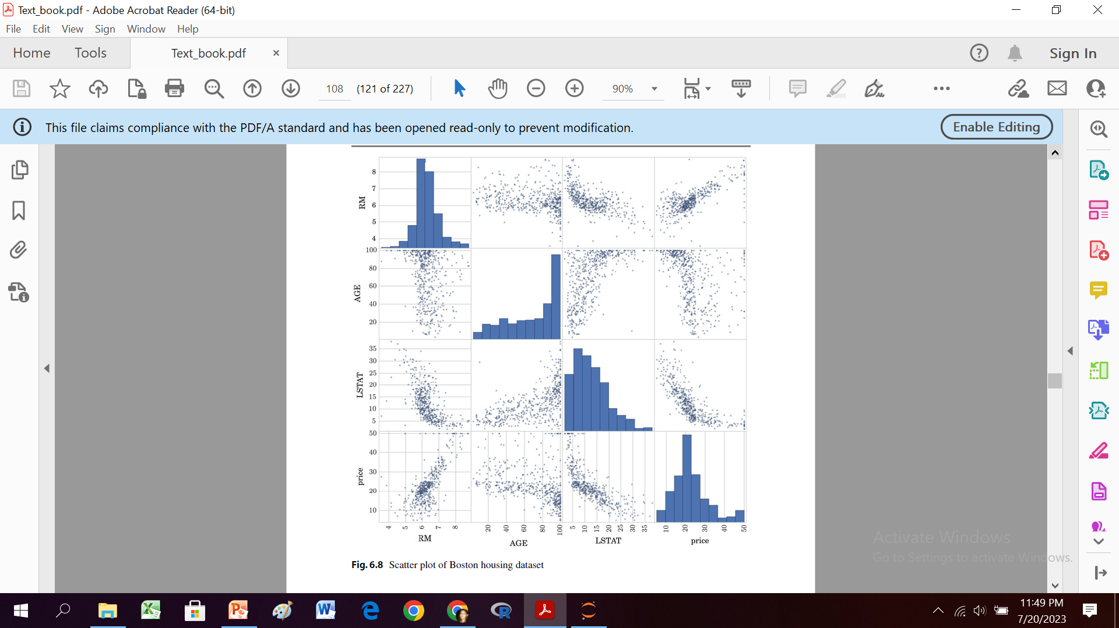
.

Slide 34
For the evaluation of the prediction power of the model with new samples, we split the data into a training set and a testing set, and we compute the linear regression score, which returns the coefficient of determination R² of the prediction.
We can also calculate the MSE.

Slide 35
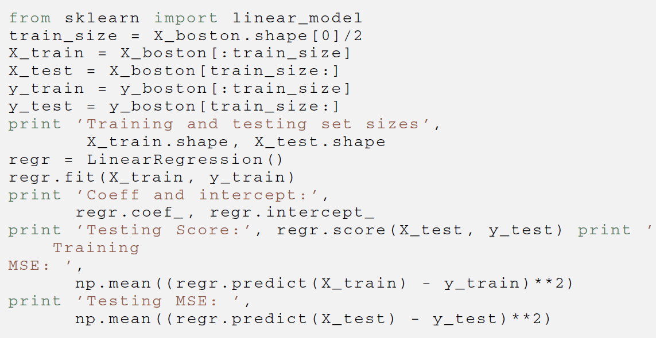
.

Slide 36
We can see that all the coefficients obtained are different from zero, meaning that no variable is discarded.
Next, we try to build a sparse model to predict the price using the most important factors and discarding the non-informative ones.
To do this, we can create a LASSO regressor, forcing zero coefficients.

Slide 37
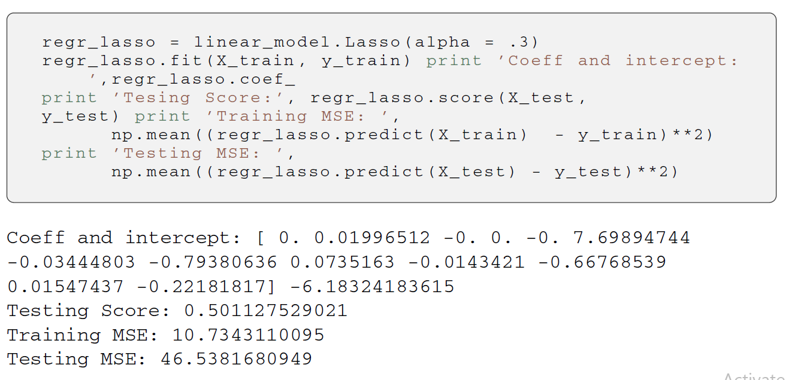
.

Slide 38
It can now be seen that the result of the model fitting for a set of sparse coefficients is much better than before (using all the variables), with the score increasing from −2.24 to 0.5.
This demonstrates that four of the initial variables are not important for the prediction and in fact they confuse the regressor.

Slide 39
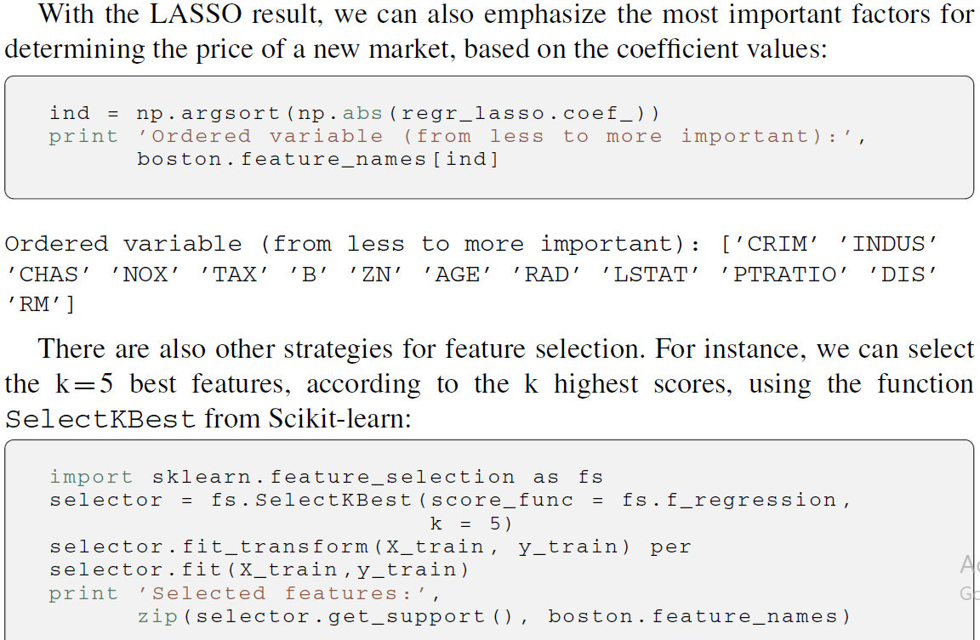
.

Slide 40
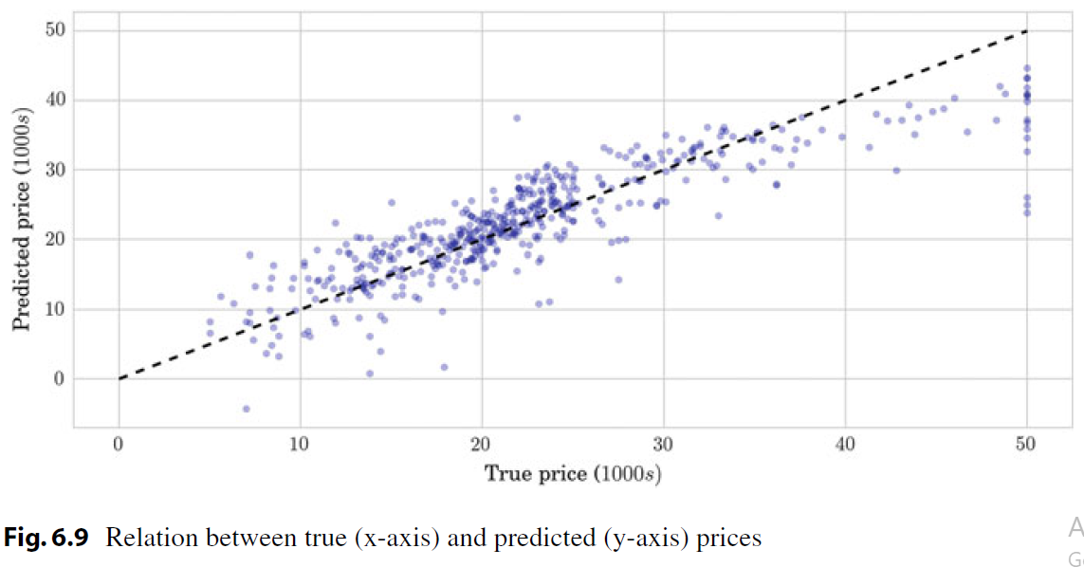
True Target versus predicted target
.

Slide 41
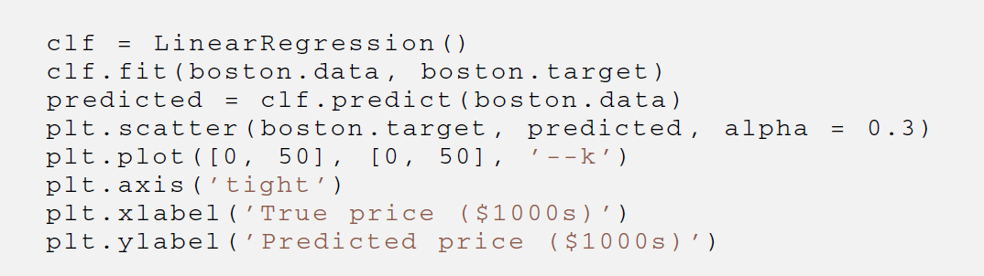
.

Slide 42
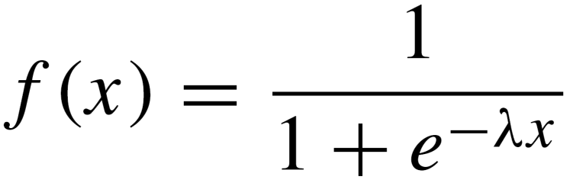
Logistic Regression
Logistic regression is a type of model of probabilistic statistical classification.
It is used as a binary model to predict a binary response, the outcome of a categorical dependent variable (i.e., a class label), based on one or more variables.
The form of the logistic function or sigmoid function is:
.

Slide 43
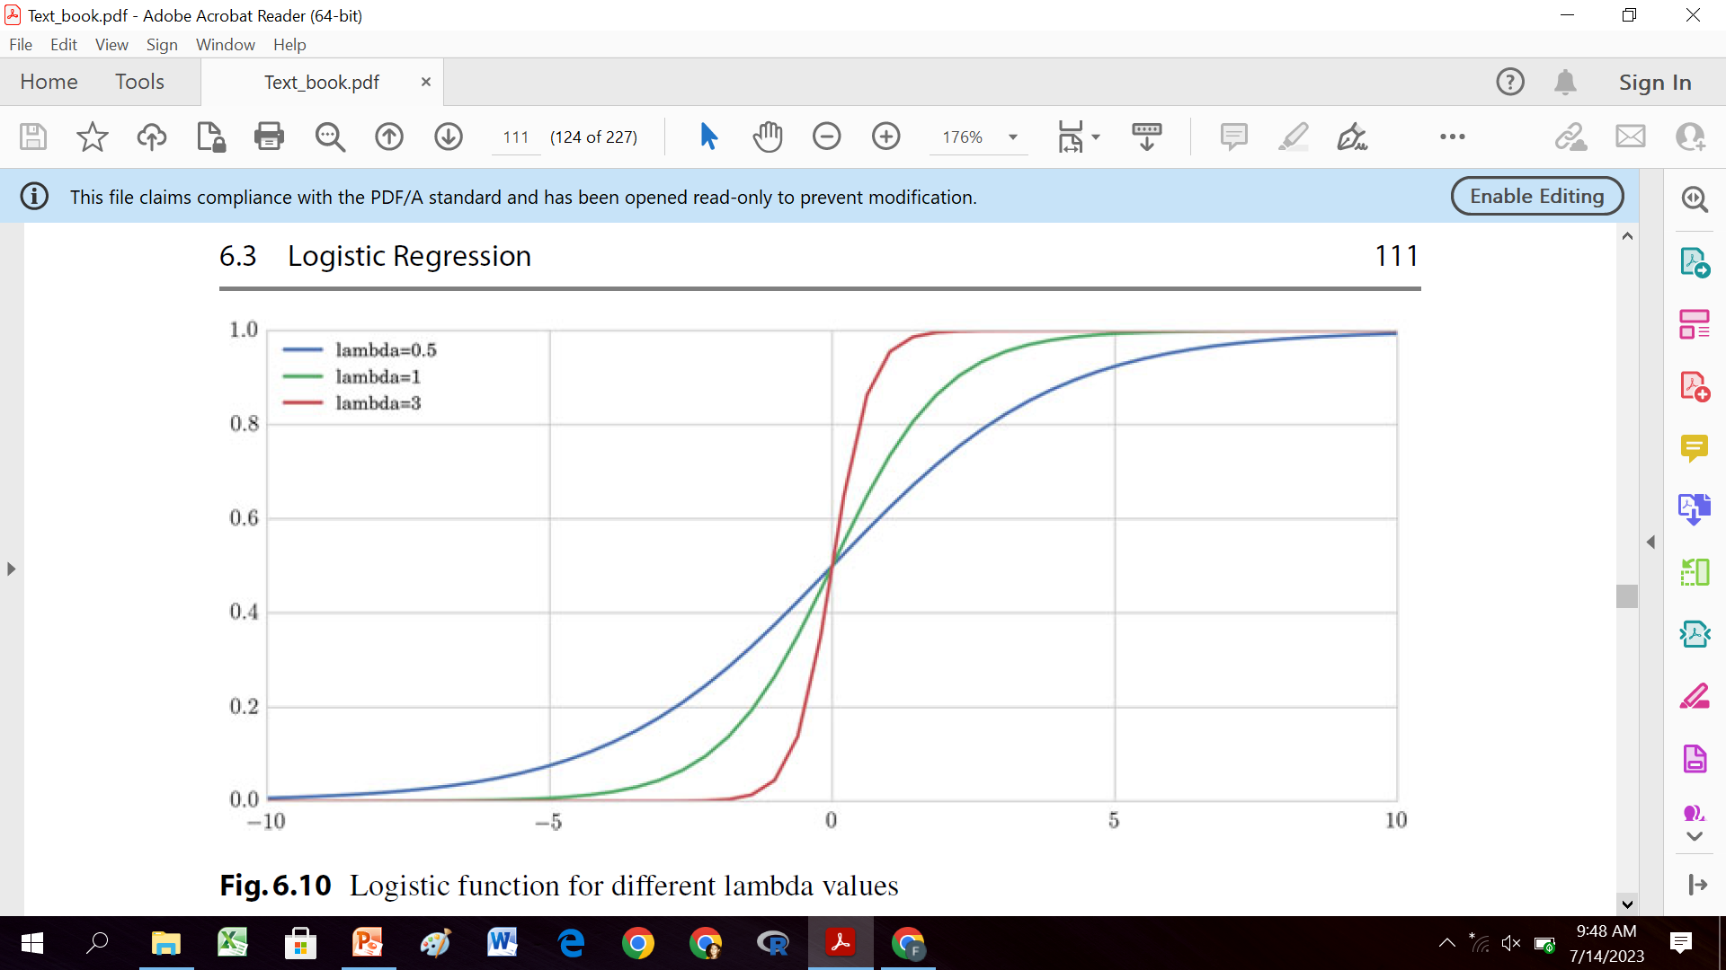
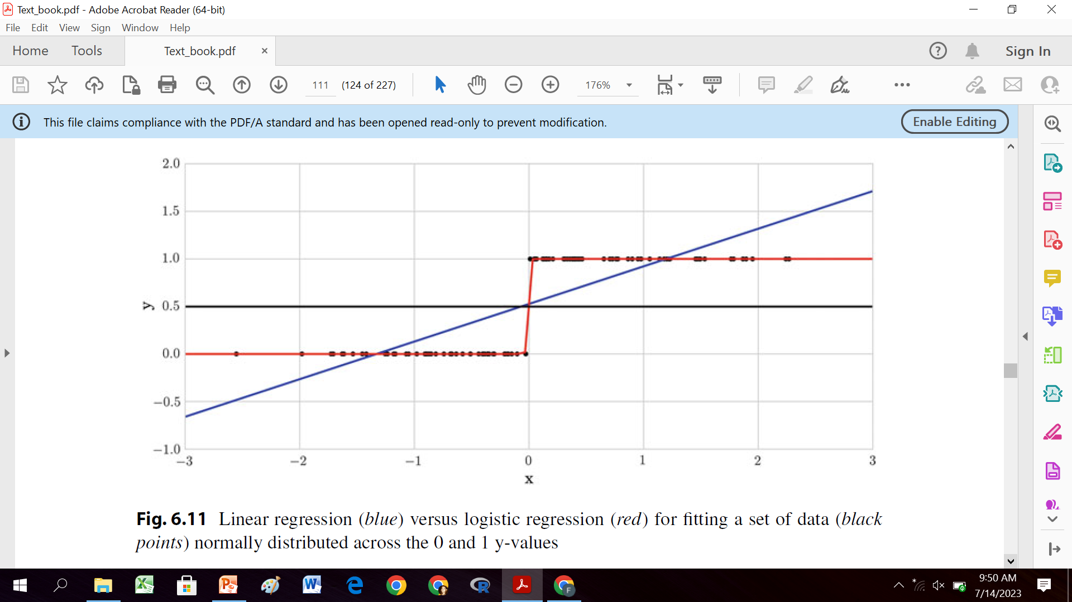
Logistic Function
.
.

Slide 44
Logistic Regression: Example
Practical Case: Winning or Losing Football Team
What number of goals makes a football team the winner or the loser?
More concretely, we want to predict victory or defeat in a football match when we are given the number of goals a team scores.
To do this we consider the set of results of the football matches from the Spanish league5 and we build a classification model with it.

Slide 45
We first read the data file in a DataFrame and select the following columns in a new DataFrame:
HomeTeam,
AwayTeam,
FTHG (home team goals),
FTAG (away team goals), and
FTR (H=home win, D=draw, A=away win).
X: a d-dimensional vector of variables with all the scores, x, and
y: a binary response indicating victory or defeat, y.
For that, we create two extra columns containing W the number of goals of the winning team and L the number of goals of the losing team and we concatenate these data.
Finally, we can compute and visualize a logistic regression model to predict the discrete value (victory or defeat) using these data.

Slide 46
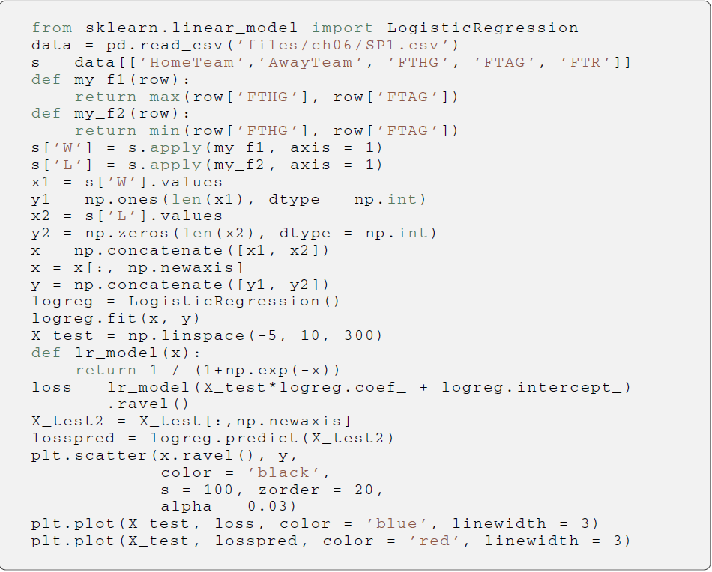
.
.

Slide 47
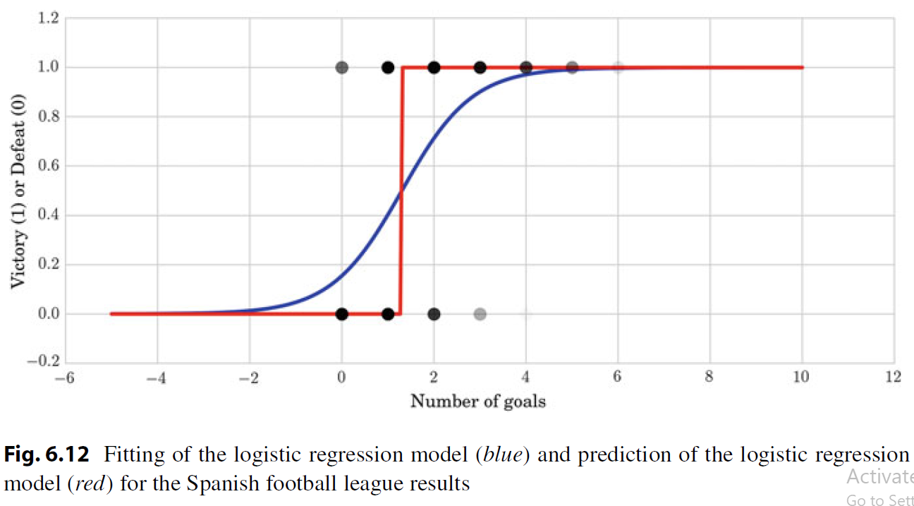
.

Slide 48
Synonyms
Independent variable
“regressors,“
“controlled variable,”
“manipulated variable,”
“explanatory variable,”
“exposure variable,”
“input variable.”
Dependent variable
“response variable,”
“regressand,”
“measured variable,”
“observed variable,”
“responding variable,”
“explained variable,”
“outcome variable,”
“experimental variable,”
“output variable.”

Slide 49
Three Practical Cases
In these practical cases, we solve different questions regarding
the behavior of the data,
the prediction of data values (continuous or discrete), and the importance of variables for the model.
Case_01: there is a decreasing tendency in the sea ice extent over the years, and we also predicted the amount of ice for the next 20 years.
Case_02: we predicted the price of a market given a set of attributes and distinguished which of the attributes were more important in the prediction.
we presented a useful way to show the correlation between pairs of variables, as well as
a way to plot the relationship between pairs of variables.
Case_03: we faced the problem of predicting victory or defeat in a football match given the score of a team.
We posed this problem as a classification problem and solved it using a logistic regression model; and
we estimated the minimum number of goals a team has to score to win.

Slide 50
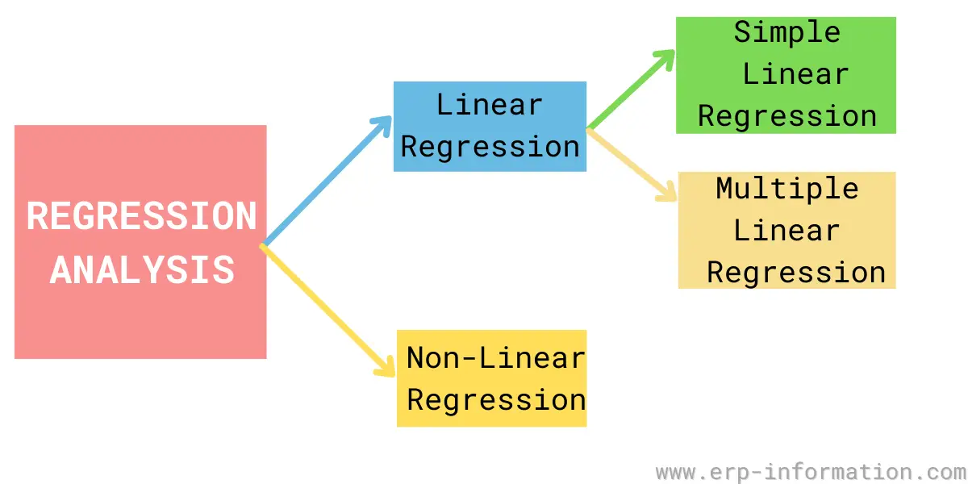
Types of regression model based on number of variables
.

Slide 51
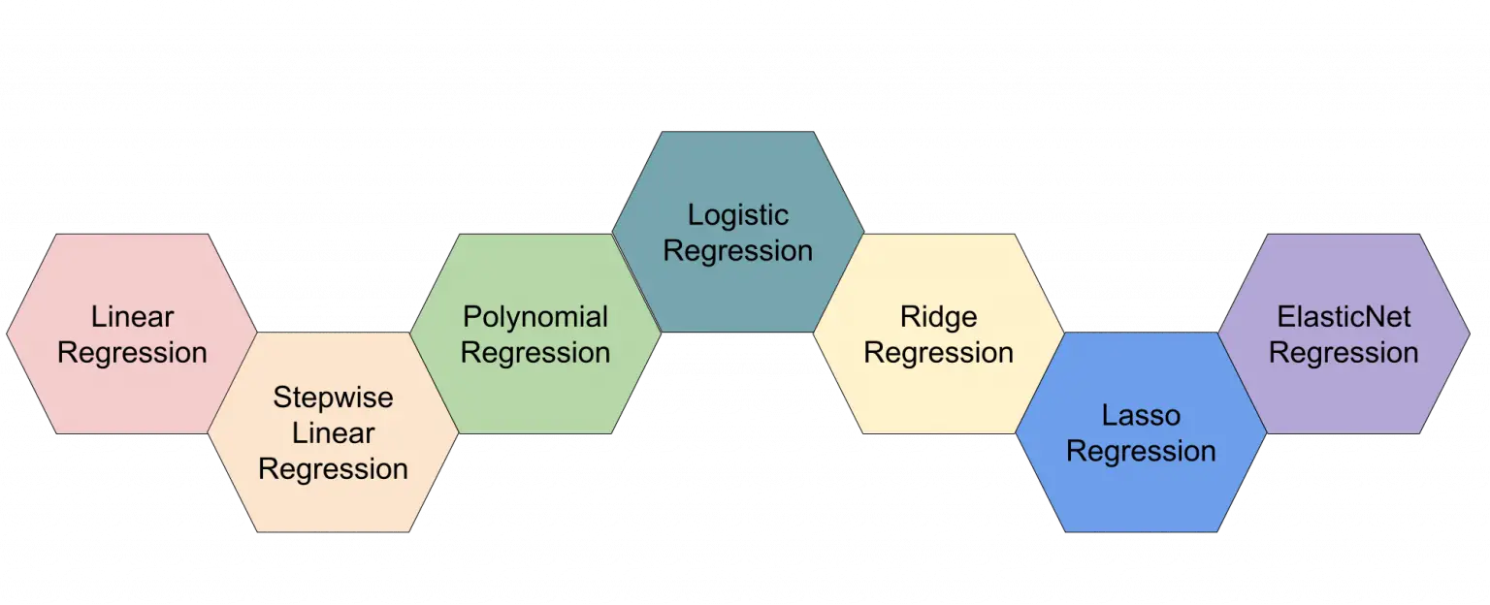
Different types of regression model
.

Slide 52
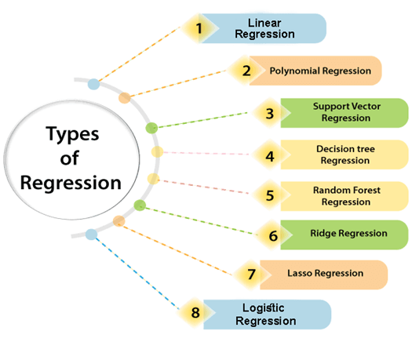
Regression algorithms
.

Slide 53
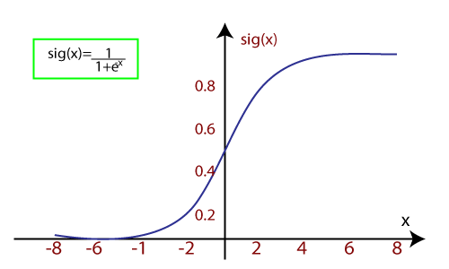
Logistic Regression
.

Slide 54
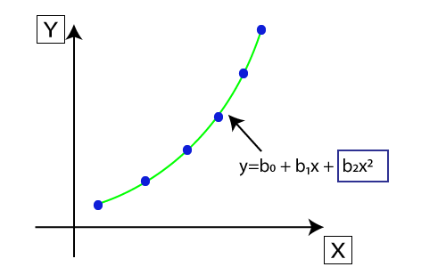
Polynomial Regression
.

Slide 55
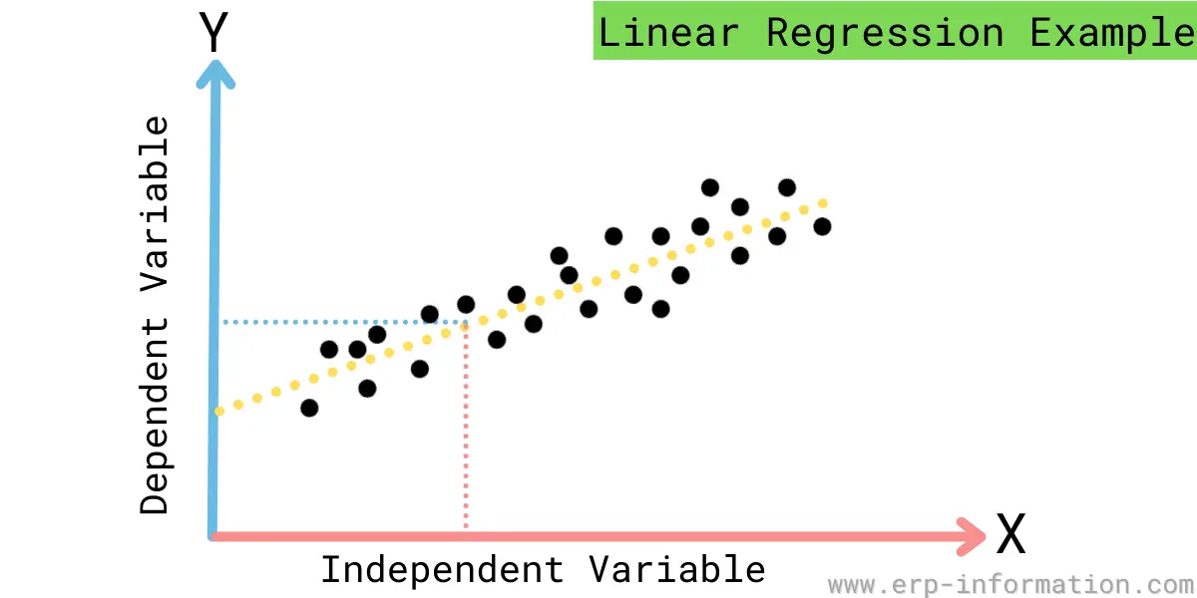
Linear Regression
.

Slide 56
summary
Regression quantifies the relationship among variable.
There are at least one dependent and at least one independent variable.
Effects on dependent variable due to change in independent variable are measured.

Slide 57
Thank you

